Slide 1
SeaSure:Ensuring Freshness in Every catch
DEVADARSHINI P 2ND BSc Data Science, Kumaraguru College of Liberal Arts and Science

Slide 2
INTRODUCTION
SeaSure is a deep learning-based model for detecting fish freshness.
Uses CNN (Convolutional Neural Networks) to analyze fish eye and gill images.
Provides a fast, objective, and reliable assessment of fish freshness.
Integrated with Streamlit for a user-friendly interface and real-time results.
OBJECTIVE
Automate fish freshness detection using deep learning.
Overcome subjective limitations of human-based evaluation.
Improve food safety and quality control in the seafood industry.
Provide a real-time, scalable, and accessible solution.

Slide 3
METHODOLOGY
Data Collection: Dataset from Roboflow, categorized into fresh/non-fresh fish.
Preprocessing & Augmentation: Resized images (128x128), normalized, and applied transformations (rotation, zoom, flipping).
Model Design: CNN architecture with Conv2D, MaxPooling2D, dropout layers, trained with Adam optimizer.
Temperature Allocation: Fresh fish (0-4°C), Non-fresh fish (5-10°C).
Visualization & Deployment: Streamlit-based interface for real-time analysis.

Slide 4
KEY FINDINGS
Achieved 91%+ accuracy in classifying fish freshness.
Model effectively classifies images into four categories: eye-fresh, eye-non-fresh, gill-fresh, gill-non-fresh.
Temperature-based freshness estimation enhances reliability.
User-friendly dashboard with confidence scores, freshness levels, and color-coded indicators.

Slide 5
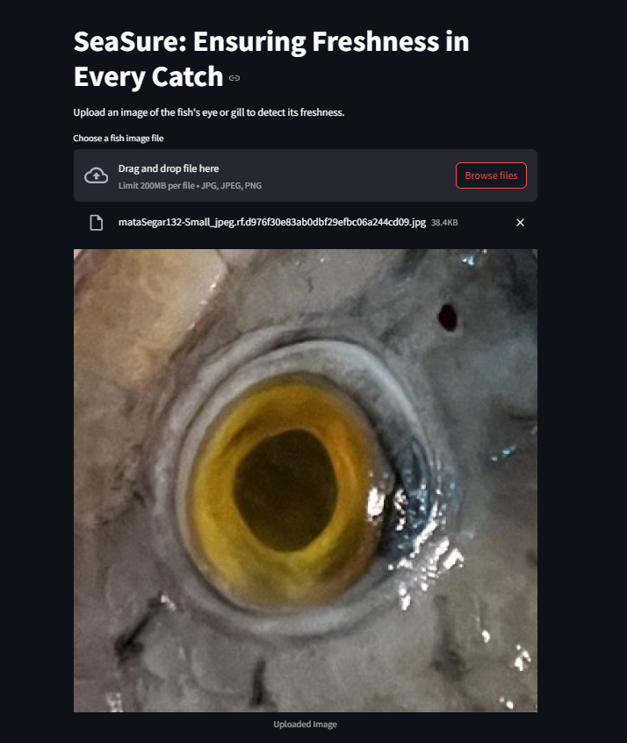
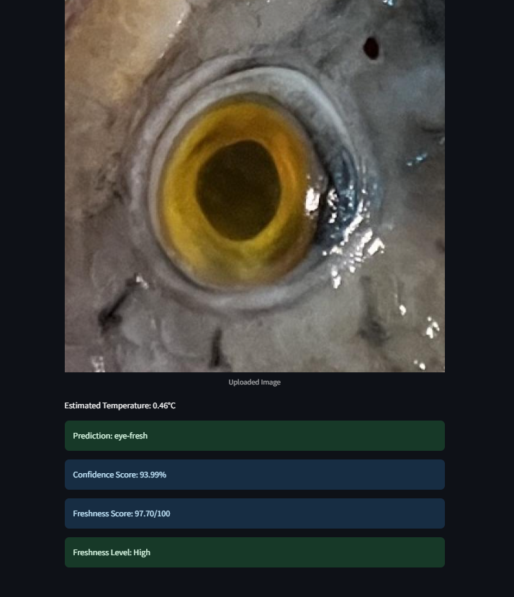

Slide 6
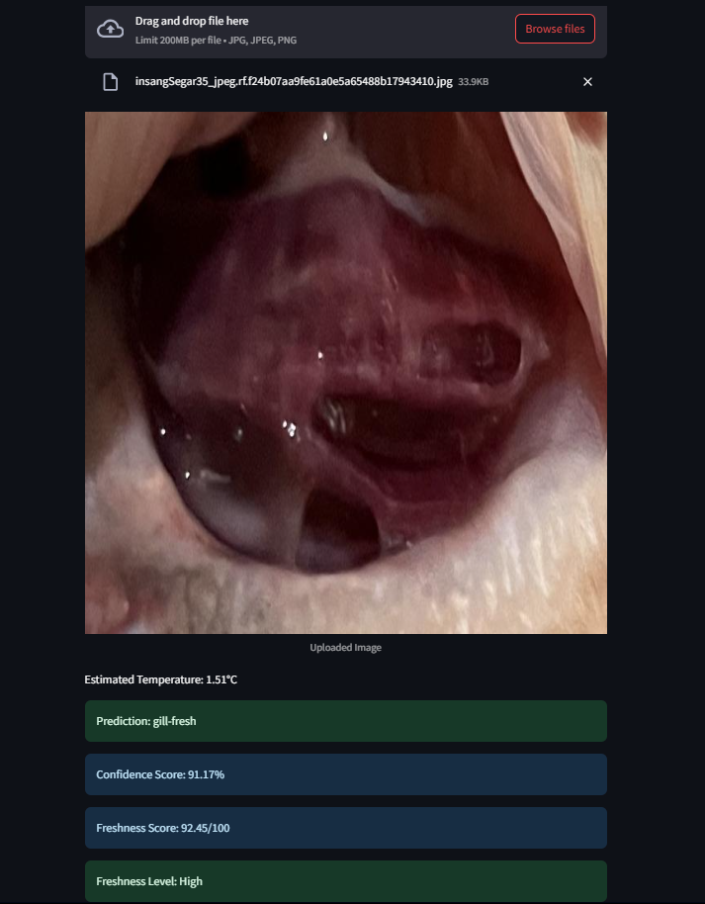
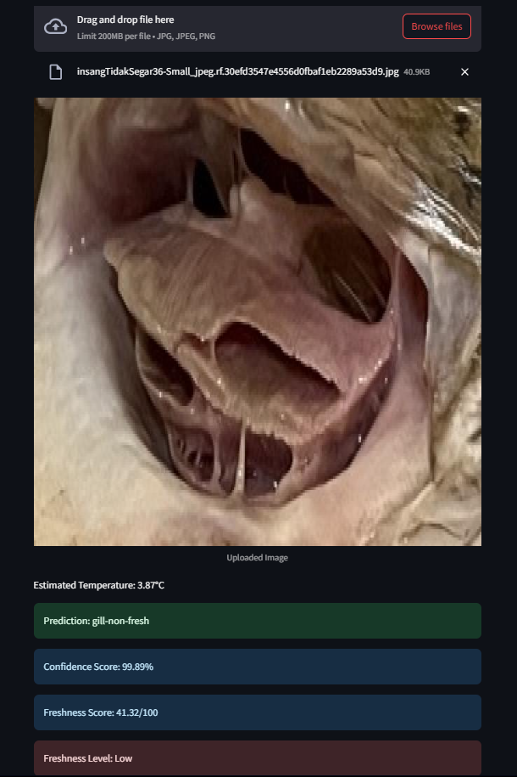

Slide 7
APPLICATIONS & IMPLICATIONS
Applications:
Seafood Industry: Helps quality control personnel quickly assess fish freshness.
Retail & Supply Chain: Ensures food safety in fish markets and distribution.
Culinary & Recipe Apps: Suggests suitable recipes based on fish freshness.
Regulatory Compliance: Supports adherence to food safety standards.
Implications:
Reduces waste by providing accurate freshness assessments.
Enhances consumer trust in seafood quality.
Saves time & resources in seafood inspection processes.
Encourages AI adoption in food safety and quality control.

Slide 8
FUTURE SCOPE
Mobile App Integration for real-time fish freshness detection via smartphones.
Expansion to Other Foods like meat and vegetables for broader AI-driven quality assessment.
Improved Dataset & Multimodal Analysis by combining visual data with biochemical sensors for greater accuracy.

